Slide 1

AGILE MODEL
PRESENTED BY K.INDRA KUMAR

Slide 2
ABOUT AGILE METHODOLOGY:
The Agile methodology is a way to manage a project by breaking it up into several phases. It involves constant collaboration with stakeholders and continuous improvement at every stage. Once the work begins, teams cycle through a process of planning, executing, and evaluating.
Agile is one of the most popular approaches to project management due to its flexibility, adaptability to change, and high level of customer input.
A project management methodology characterized by building products using short cycles of work that allow for rapid production and constant revision.

Slide 3
ROLES IN AGILE
1.SCRUM MASTER :
The Scrum Master is a team leader and facility provider who helps the team member to follow agile practices, so that the team member meets commitments and customers requirements.
They enable the close co-operation between all the roles and functions.
They remove all the blocks which occur.
They safeguard the team from any disturbances.
They work with the organization to track the progress and processes of the company.
2. PRODUCT OWNER :
The Product Owner is one who runs the product from a business perspective. The Product Owner plays the following responsibilities:
He defines the requirements and prioritizes their values.
He sets the release date and contents.
He takes an active role in iteration and releasing planning meetings.
He ensures that the team is working on the most valued requirement.
He represents the voice of the customer.
He accepts the user stories that meet the definition of done and defined acceptance criteria.

Slide 4
AGILE METHODOLOGY:
ADVANTAGES
DISADVANTAGES
Customer satisfaction is rapid, continuous development and delivery of useful software.
Customer, Developer, and Product Owner interact regularly to emphasize rather than processes and tools.
Product is developed fast and frequently delivered (weeks rather than months.)
A face-to-face conversation is the best form of communication.
It continuously gave attention to technical excellence and good design.
Daily and close cooperation between business people and developers.
Regular adaptation to changing circumstances.
Even late changes in requirements are welcomed.
It is not useful for small development projects.
There is a lack of intensity on necessary designing and documentation.
It requires an expert project member to take crucial decisions in the meeting.
Cost of Agile development methodology is slightly more as compared to other development methodology.
The project can quickly go out off track if the project manager is not clear about requirements and what outcome he/she wants.

Slide 5
PRINCIPLES OF AGILE MANIFESTO
THE 12 PRINCIPLES ARE:
1.CUSTOMER SATISFICATION 8. MAINTAIN CONSTANT PACE
2. WELCOME CHANGE 9. MONITORING
3. DELIEVER THE WORKING SOFTWARE 10. SIMPLICITY
4.COLLABORATION 11. SELF ORGANIZED TEAMS
5. MOTIVATION 12.REVIEW THE WORK REGULARLY
6.FACE TO FACE CONVERSATION
7.MEASURES THE PROGRESS AS PER THE WORKING SOFTWARE

Slide 6
AGILE CHARACTERISTICS
Agile development releases and fixed-length iterations
Agile development delivers working,tested software
Value- driven development
Continuous planning
Multi-level planning in agile development
Relative estimation
Emergent feature discovery
Continuous testing 10. Small, cross functional teams
Continuous improvement

Slide 7
AGILE SCRUM
Scrum is a framework that helps agile teams to work together. Using it, the team members can deliver and sustain the complex product. It encourages the team to learn through practice, self-organize while working on the problem. Scum is a work done through the framework and continuously shipping values to customers.
It is the most frequent software that is used by the development team. Its principle and lessons can be applied to all kinds of teamwork. Its policy and experiences is a reason of popularity of Scrum framework. The Scrum describes a set of tools, meetings, and roles that help the teams structure. It also manages the work done by the team.

Slide 8
PRINCIPLE OF KANBAN
Kanban is a popular framework which is used to implement agile software development. It takes real time communication of capacity and complete transparency of work. The work items are represented in a kanban board visually, allowing team members to see the state of every piece of work at any time.
PRINCILPES OF KANBAN ARE:
Visualize
Limit work in progress
Manage flow 6. Improve collaboratively, evolve experimentally
Make policies explicit
Implement feedback loops

Slide 9
EXTREME PROGRAMMING
Extreme Programming (XP) is an agile software development framework that aims to produce higher quality software, and higher quality of life for the development team. XP is the most specific of the agile frameworks regarding appropriate engineering practices for software development.
Extreme programming can work well for teams that: Expect their system's functionality to change every few months. Experience constantly changing requirements or work with customers who aren't sure what they want the system to do. Want to mitigate project risk, especially around tight deadlines.

Slide 10
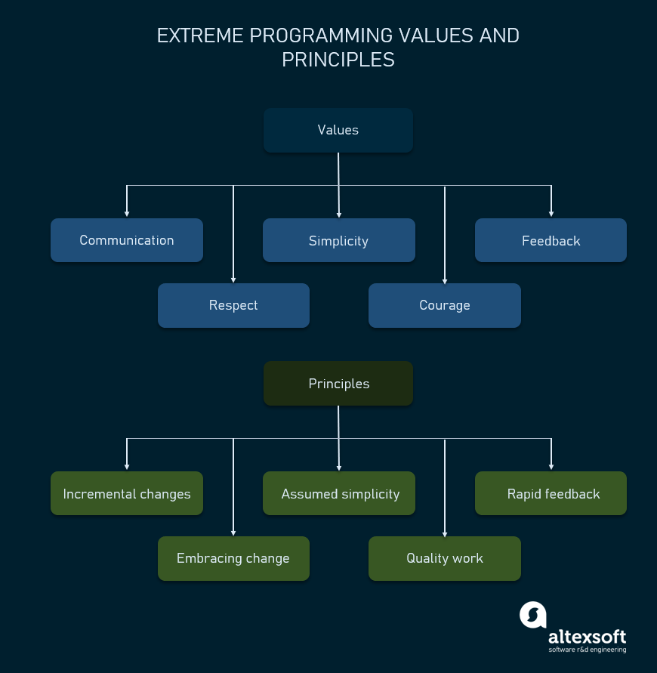
PRINCIPLES AND VALUES OF EXTREME PROGRAMMING

Slide 11

THANK YOU

